Slide 1
Earned Income Tax Credit
How Education Rates are Impacted

Slide 2
My Question and Why Its Important
How does tax credits such as the EITC received between the ages of 10 and 16 affect high school and college education attainment?
If there exists tax policy that can help lower income children become more educated this results in a multitude of good outcomes both on an individual level and for the broader population
A more educated population has lower crime rates, higher income and thus taxes paid, is happier and has better health outcomes

Slide 3
Economic Understanding
An increase in income should allow for either more disposable income if basic needs are met, the ability to decrease labor input, or a heightened ability to meet basic needs
If this increase in income allows for more disposable income then this income could be routed to increased quality of food, or supplies or services that directly help with schooling like notebooks, internet access or tutoring
If parents are able to decrease labor input they could reallocate time to helping their children with academic assistance such as helping with homework, or just creating a more structured routine
If they are now able to meet basic needs this decreases stress in the household, provides stability, helps with food insecurity, etc. When basic needs aren’t met we can come up with lots of things that negatively impact a child’s ability to learn

Slide 4
Variables
Independent Variables:
CURRENT STATE,
MOTHERS EDUCATION,
FATHERS EDUCATION,
TOTAL FAMILY INCOME,
RELATIONSHIP TO HEAD (OF HOUSEHOLD),
AGE OF INDIVIDUAL,
SEX,
RACE,
EITC EXPOSURE (Calculated as FEDERAL EITC + STATE EITC)
Where STATE EITC is a percentage of FEDERAL EITC by state
Dependent Variable:
EDUCATION ATTAINED

Slide 5
Largest Data Cleaning Challenge
Challenge:
The PSID uses variable names that without access to the codebook are incomprehensible (Ex. ER3002) and the provided labels are inconsistent. I wanted to be able to match the original variable to a consistent label without having to manually change the variable name within my code.
Solution:
The first step I used to accomplish this was adjusting the label text file to have consistent labels and years within it. Then using macro variables and SQL I created a rename list that automatically changed the imported column namess in the dataset to match the one in the codebook.

Slide 6
Results of Analysis
Each of my regressions were able to explain about 10% of the variation in education rates. For a multifaceted problem like “How do we encourage education success” this is a satisfactory result yet still a serious limitation. Due to this limitation my regressions found that the Earned Income Tax Credit had a negative impact on education success at all levels (High School completion, college attendance and Bachelors completion). It is important to mention that based on my correlation matrix, which found that the EITC was positively correlated with education success, I can conclude this result is most likely due to missing variable bias. This means that if the important missing variables are found and controlled for then this limitation could be overcome.

Slide 7
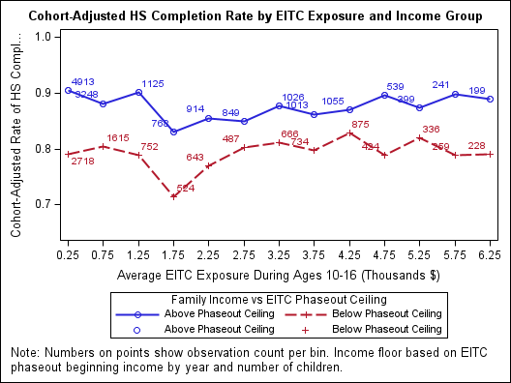
Visual For High School Completion
The group that could not receive EITC is operating as expected. There’s a general trend where around 85% of people complete high school regardless of EITC.
The group that could receive EITC is not operating as expected. It seems to stay rather constant around a 80% High school completion rate except at the $1750 bin.

Slide 8
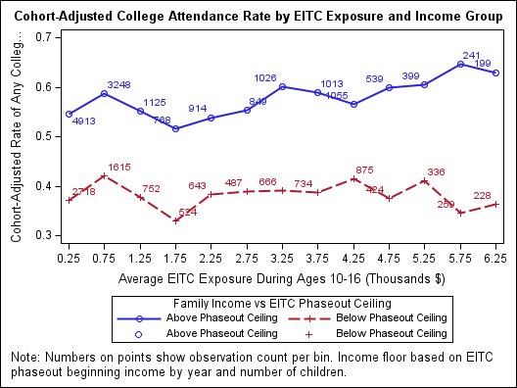
Visual For College Attendance
The group that could not receive EITC seems to have a slight positive slope indicating that EITC has a positive impact on college attendance. This is unexpected since they could not receive it.
The group that could receive EITC had a either flat or somewhat downward trending slope

Slide 9
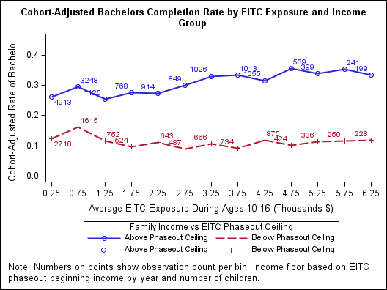
Visual For Bachelors Completion
The group that could not receive EITC seems to have a slight positive slope indicating that EITC has a positive impact on bachelors completion. This is once again unexpected since they could not receive it.
The group that could receive EITC seems to have a rather flat slope contrary to expectations

Slide 10
Visuals Discussion
Based on the key’s the red line represents people who’s family income is low enough to qualify for the EITC while the blue line represents people who’s family income is too high. I would have expected the red line to increase as EITC exposure increases since extra income should have a positive impact on education. I would have expected the blue line to stay fairly stagnant as EITC increases since they did not receive the tax credit.
However, none of the plots showed this story and it is likely because we are missing some of the context. Without full context (Missing variables) it is possible that the impact allocated to EITC is over or understated (Absorbing the variation of other variables). This is likely to be they case because my model is only able to explain about 10% of the variation in education rates.

Slide 11
Sources
Earned income tax credit parameters, 1975-2016. (n.d.-a). https://taxpolicycenter.org/sites/default/files/legacy/taxfacts/content/pdf/historical_eitc_parameters.pdf
PSID Home. (n.d.-b). https://psidonline.isr.umich.edu/default.aspx
TAXSIM related files at the NBER - MyNBER. (n.d.). https://taxsim.nber.org/state-eitc.html

